Slide 1







CS-363 TERM PAPER REVIEW
Title: QuIM-RAG
Advancing Retrieval-Augmented Generation With Inverted Question Matching for Enhanced
QA Performance
Presented by Batch-07

Slide 2




Batch - 07
Review - 0
Guide:
Dr. M. Sreelatha
Instructor:
Dr. G. Srinivasa Rao
Team Members:
Pradeep Kumar (Y22CS048)
Naga Avinash Babu (Y22CS044)

Slide 3



Abstract...
Large Language Models (LLMs) are powerful tools that analyze and generate human-like text but struggle with real-time updates.
Retrieval-Augmented Generation (RAG) improves LLMs by integrating online resources for more accurate and context-aware answers.
Traditional RAG models face challenges like handling large amounts of data, leading to information dilution and incorrect responses (hallucinations).
This paper introduces QuIM-RAG (Question-to-question Inverted Index Matching), a new method that improves how AI retrieves relevant information.
Instead of simply searching documents, QuIM-RAG generates possible questions from document chunks and matches them with user queries for better accuracy.

Slide 4
Contd...
The system is built on Meta-LLaMA3-8B-instruct, an open-source AI model, and is tested using a custom dataset of 500+ pages from a popular website.
A manual QA evaluation was performed to ensure high accuracy and reliability of responses.
The performance of QuIM-RAG was compared with traditional RAG models using BERT-Score and RAGAS, two advanced AI evaluation methods.
Results show that QuIM-RAG outperforms traditional RAG systems by generating more precise and reliable answers.
This research provides a better way to retrieve and generate answers, making AI-driven question-answering more effective.

Slide 5

Goal...
The goal of the project is to develop QuIM-RAG, an advanced Retrieval-Augmented Generation system that improves the accuracy and relevance of answers for domain-specific questions by addressing issues like information dilution and hallucinations.
It aims to create a high-quality, custom dataset from North Dakota State University websites and introduce a novel inverted question-matching approach with quantized embeddings for efficient retrieval.
Using the Meta-LLaMA3-8B-instruct model, QuIM-RAG seeks to outperform traditional RAG systems, as evaluated by BERT-Score and RAGAS metrics, while providing source links to enhance user trust and interaction.

Slide 6
Existing Models
Large Language Models (LLMs):
These models, primarily based on Transformer architectures (decoders for GPT, encoders for BERT/RoBERTa, or both for BART), excel at generating human-like text and handling various linguistic tasks. They are trained on broad, general datasets, making them versatile but less effective for domain-specific QA due to:
Knowledge Limitations: Lack of specialized knowledge in niche domains.
Hallucinations: Producing factually inaccurate responses when data is missing or misinterpreted.
Contextual Misinterpretation: Struggling with domain-specific context, leading to irrelevant answers

Slide 7
Existing Models
Traditional Retrieval-Augmented Generation (RAG):
RAG enhances LLMs by integrating external knowledge sources (e.g., databases, websites) to provide contextually relevant answers. It consists of:
Retrieval Component: Converts a corpus into vectors using an embedding model, stores them in a vector database, and matches user queries to relevant text chunks using similarity measures (e.g., cosine similarity).
Generation Component: An LLM generates responses using the retrieved text as context.
Challenges:
Information Dilution: Large data volumes reduce response specificity and accuracy.
Hallucinations: The model may generate coherent but factually incorrect outputs.
Inefficient Retrieval: Standard vector-based retrieval struggles with precision when handling vast datasets, often retrieving irrelevant or overly broad context.

Slide 8
Existing Models
Probably Asked Questions (PAQ) and RePAQ
PAQ involves generating question-answer pairs to cover knowledge gaps in LLMs, while RePAQ is a QA-pair retriever that enhances efficiency in retrieving relevant QA pairs for answering queries.
Purpose: Aims to bridge knowledge gaps in LLMs by pre-generating questions that might be asked, improving QA performance.
Limitations: While innovative, these approaches are less focused on custom dataset creation or efficient retrieval mechanisms tailored to specific domains, and they may not fully address issues like information dilution or computational complexity in large-scale retrieval.

Slide 9
How QuIM-RAG Differs from Previous Models
QuIM-RAG (Question-to-question Inverted Index Matching) introduces a novel approach to address the limitations of traditional LLMs, RAG systems, and PAQ/RePAQ.
1. Custom Domain-Specific Dataset:
Previous Models: Traditional RAG and LLMs often rely on general or publicly available datasets, which may lack depth in niche domains (e.g., university-specific information). PAQ/RePAQ generate QA pairs but do not emphasize structured, domain-specific dataset creation.
QuIM-RAG Difference: Creates a custom dataset from 687 pages of North Dakota State University (NDSU) websites (Career Advising and Catalog), resulting in 731 chunks and 22,609 questions. This dataset is meticulously curated through web scraping (using BeautifulSoup and Scrapy), chunking (1000-token chunks with 200-character overlaps), and manual review to ensure accuracy and relevance. This reduces information dilution by focusing on high-quality, domain-specific content.

Slide 10
How QuIM-RAG Differs from Previous Models
2. Inverted Question-Matching Mechanism:
Previous Models: Traditional RAG uses vector-based retrieval, where queries are matched directly to document embeddings using cosine similarity. This can retrieve irrelevant or overly broad context, especially with large datasets. PAQ/RePAQ focus on QA pairs but do not use an inverted index or question-matching approach.
QuIM-RAG Difference: Introduces an inverted question-matching approach:
Question Generation: Uses GPT-3.5-turbo-instruct to generate potential questions for each document chunk, encapsulating key information (like "frequently asked questions").
Embedding and Quantization: Converts questions into embedding vectors (using BAAI/bge-large-en-v1.5) and quantizes them to prototypes to reduce computational complexity
Inverted Index: Builds an inverted index mapping prototypes to embedding vectors and their corresponding text chunks.
Query Processing: Matches user queries to generated questions (not directly to documents) by embedding and quantizing the query, rerieving the top 3 most similar questions (k=3), and fetching associated chunks. This improves retrieval precision by focusing on semantically relevant questions.

Slide 11
How QuIM-RAG Differs from Previous Models
3. Enhanced Retrieval Efficiency
Previous Models: Traditional RAG’s vector-based retrieval can be computationally expensive due to direct comparisons in high-dimensional embedding spaces. PAQ/RePAQ improve QA pair retrieval but do not optimize for large-scale, domain-specific corpora.
QuIM-RAG Difference: Uses quantization and an inverted index to reduce computational load, enabling faster and more efficient retrieval. The ChromaDB vector database stores quantized embeddings, making similarity searches more scalable and precise.

Slide 12

Methodology with Architecture Diagrams…
Phase-I of Methodology
Web Scraping:
The system scrapes data from the websites:
Extracted HTML content is cleaned by removing headers, footers, and redundant data.
Chunking & Overlapping Windows:
The scraped text is broken into 1000-token segments with an overlapping window of 200 tokens to retain contextual continuity.
Question Generation:
GPT-3.5-turbo-instruct generates multiple potential questions from each chunk.
Ensures that all key information in a chunk is covered by at least one question.
Final Structured Dataset
Each chunk is stored along with its generated questions and source links.
This dataset forms the basis for retrieval in the later phases.

Slide 13
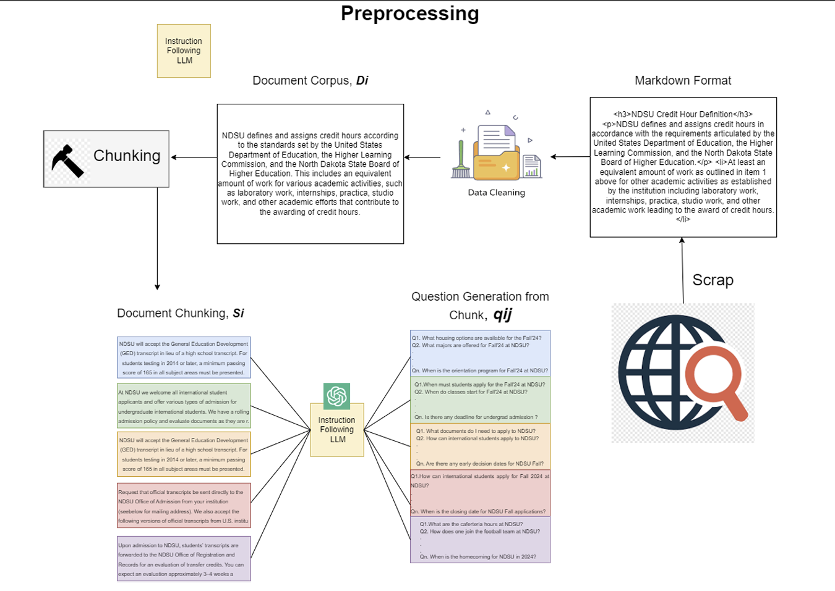

Phase-I Architecture Diagram ...
Overall Architecture of Corpus Preparation

Slide 14
Phase – II of Methodology
Embedding Questions & Chunks::
Generated questions are converted into vector embeddings using BAAI/bge-large-en-v1.5 from Hugging Face.
Each chunk also has an associated embedding.
Quantization & Inverted Indexing:
Embedding vectors are quantized to prototype vectors, reducing storage and improving retrieval speed.
The system creates an inverted index, mapping each prototype vector to its corresponding questions and chunks.

Slide 15
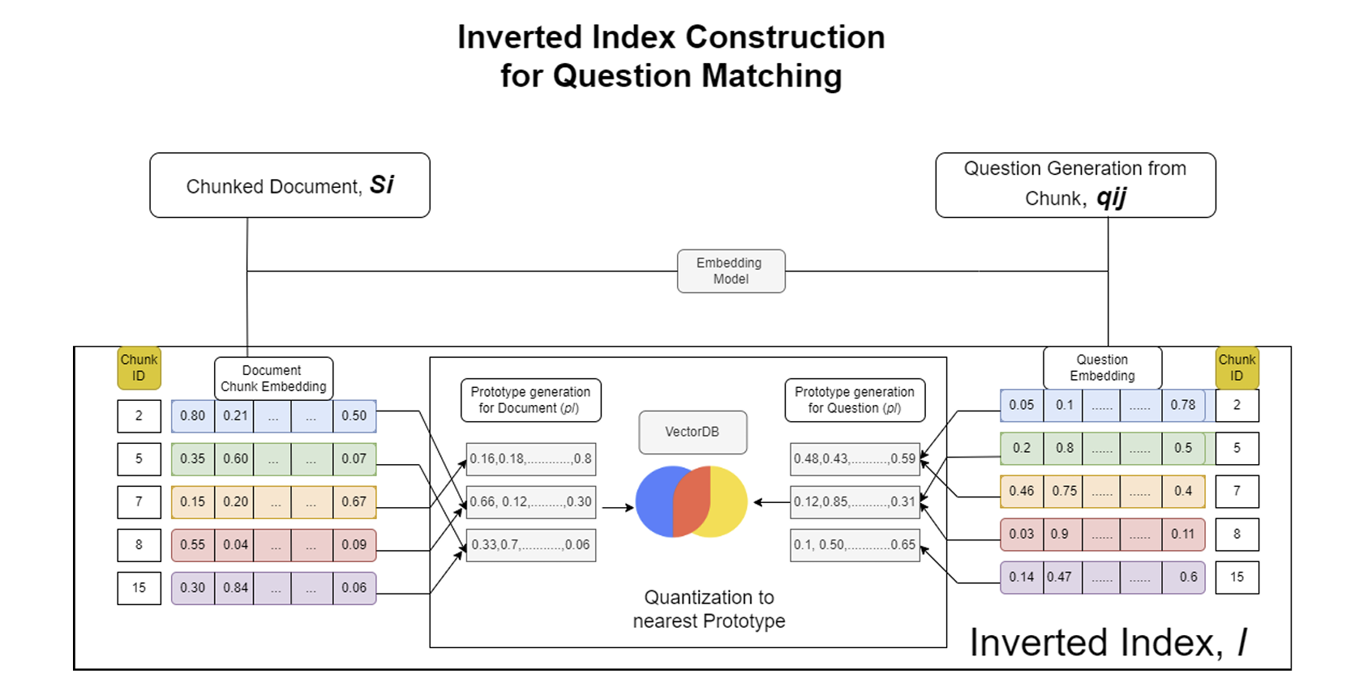
Phase-II Architecture Diagram ...

Slide 16
Phase – III of Methodology
Query Processing:
The user submits a question.
It is embedded and quantized using the same vectorization method as the stored data.
Question Matching & Retrieval:
The system finds the top k matching questions in the inverted index.
Corresponding document chunks are retrieved.
Answer Generation with Llama3-8B-instruct::
Retrieved chunks are fed into Meta-LLaMA3-8B-instruct.
The model generates a contextually accurate response using a custom
prompt.
The user receives a well-structured, contextually relevant answer

Slide 17
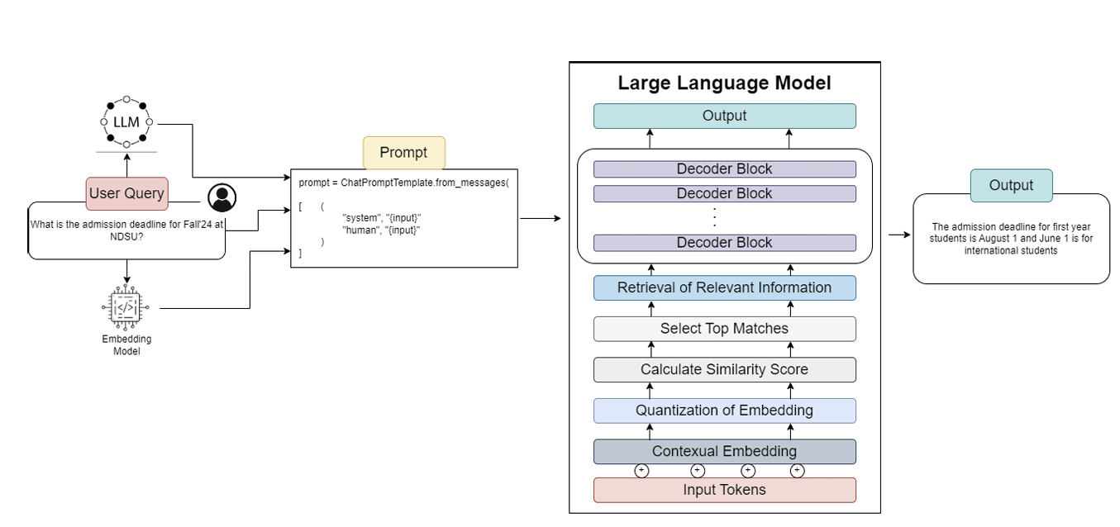
Phase-III Architecture Diagram...
Overall Retrieval and Generation Architecture for RAG.

Slide 18


Methodology
The QuIM-RAG methodology is designed to enhance Retrieval-Augmented Generation (RAG) by improving how queries are matched to document chunks through Inverted Question Matching.
This method ensures better accuracy and reduces hallucination in domain-specific question-answering tasks.
Step 1: Data Collection & Chunking
Objective:
Gather relevant domain-specific data.
Split data into smaller, meaningful chunks for efficient retrieval.
Process:
Web Scraping:
The system scrapes web pages from NDSU Career Advising & Catalog websites.
Extracts text while removing unnecessary elements (headers, footers, navigation menus).
Text Preprocessing:
Cleans the raw text by removing special characters, HTML tags, and irrelevant words.
Ensures only meaningful content is retained.
Document Chunking:
Breaks down long documents into smaller segments (chunks).
Each chunk is 1000 tokens long with a 200-token overlap to preserve context.

Slide 19
Example
Step 1: Chunked Data from Documents
Chunk ID | Extracted Text from Documents
C1 | "Students can find internship opportunities through CareerLink or external job portals. Applications must be submitted before the deadline, and some internships require departmental approval."
C2 | "Applicants must prepare a resume, cover letter, and sometimes a recommendation letter. Some companies may also require a transcript or writing sample."
C3 | "Internship applications are submitted via CareerLink. Students must verify eligibility based on their major before submission. Departmental approval is sometimes required."
C4 | "The Career Center offers resume reviews, mock interviews, and one-on-one coaching to help students improve their applications."

Slide 20
Step 2: Question Generation from Chunks
Objective:
Create potential questions from each document chunk to improve retrieval accuracy..
Process:
Using GPT-3.5-turbo-instruct to generate questions for each chunk.
Ensures each question captures key information within the chunk.
Generated Questions for Each Chunk
🔹 Chunk C1 (Internship Process & Approval)
"Where can NDSU students find internship opportunities?"
"What are the steps to apply for an internship at NDSU?"
"Are internships at NDSU approved by departments?"
"What is the deadline for internship applications?"
🔹 Chunk C2 (Required Documents for Application)
"What documents are required for an internship application?"
"Do I need a cover letter for an internship?"
"Is a recommendation letter mandatory for internship applications?"
"Do some companies require transcripts for internship applications?"
🔹 Chunk C3 (Submission Process & Eligibility)
"Where should internship applications be submitted?"
"How do students verify their eligibility for an internship?"
"Is departmental approval required for internship applications?"
"What happens if a student is not eligible for an internship?"
🔹 Chunk C4 (Career Center Assistance)
"How can the Career Center help with internship applications?"
"Does the Career Center offer resume reviews?"
"Can students get mock interview practice at the Career Center?"
"Does the Career Center provide one-on-one coaching for job applications?"

Slide 21
Step 3: Convert All Questions into Embedding Vectors
Each generated question is converted into a high-dimensional embedding vector using the BAAI/bge-large-en-v1.5 embedding model. These embeddings allow semantic similarity search, making retrieval more accurate than traditional keyword matching.
Embedding Process
Use BAAI/bge-large-en-v1.5 to generate vector representations for each question.
Each embedding vector is a set of floating-point numbers in high-dimensional space (e.g., 768 or 1024 dimensions).
Similar questions have embeddings that are closer in vector space, making retrieval more precise.
Embeddings are stored in an inverted index, linking each question to its corresponding document chunks.
Example: Generated Questions & Their Embeddings
Generated Question | Embedding Vector (Example Values)
"Where can NDSU students find internship opportunities?" | (0.12, -0.45, 0.78, ..., 0.98)
"What are the steps to apply for an internship at NDSU?" | (0.34, -0.67, 0.45, ..., 0.91)
"Where should internship applications be submitted?" | (0.44, -0.33, 0.69, ..., 0.90)

Slide 22
Generated Question | Embedding Vector | Linked Chunks
"Where can NDSU students find internship opportunities?" | (0.12, -0.45, 0.78, ..., 0.98) | C1
"What are the steps to apply for an internship at NDSU?" | (0.34, -0.67, 0.45, ..., 0.91) | C1, C3
"Are internships at NDSU approved by departments?" | (0.41, -0.58, 0.32, ..., 0.87) | C1, C3
"What is the deadline for internship applications?" | (0.19, -0.30, 0.88, ..., 0.92) | C1
"What documents are required for an internship application?" | (0.55, -0.23, 0.68, ..., 0.88) | C2, C3
"Do I need a cover letter for an internship?" | (0.25, -0.61, 0.39, ..., 0.86) | C2
"Is a recommendation letter mandatory for internship applications?" | (0.48, -0.52, 0.44, ..., 0.85) | C2
"Where should internship applications be submitted?" | (0.44, -0.33, 0.69, ..., 0.90) | C3
"How do students verify their eligibility for an internship?" | (0.31, -0.47, 0.71, ..., 0.93) | C3
"How can the Career Center help with internship applications?" | (0.21, -0.50, 0.82, ..., 0.94) | C4
"Does the Career Center offer resume reviews?" | (0.38, -0.46, 0.79, ..., 0.95) | C4
"Can students get mock interview practice at the Career Center?" | (0.29, -0.55, 0.72, ..., 0.89) | C4

Slide 23
Step 4: Apply Embedding Quantization
Instead of storing individual embeddings, QuIM-RAG quantizes them by grouping similar embeddings together.
Each prototype vector (centroid) represents a group of similar embeddings.
Each question is mapped to the nearest prototype vector using cosine similarity.
Example of Prototype Vector Assignment
Prototype Vector (Quantized Embedding) | Mapped Question Embeddings | Linked Chunks
P1 (0.12, -0.45, 0.78, ...) | "Where can NDSU students find internship opportunities?" "How do students search for internships?" | C1
P2 (0.34, -0.67, 0.45, ...) | "What are the steps to apply for an internship at NDSU?" "How do I submit an internship application?" | C1, C3
P3 (0.55, -0.23, 0.68, ...) | "What documents are required for an internship application?" "Is a resume necessary for an internship?" "Do internships require cover letters?" | C2, C3
P4 (0.44, -0.33, 0.69, ...) | "Where should internship applications be submitted?" "What platform is used for internship applications?" | C3
P5 (0.21, -0.50, 0.82, ...) | "How can the Career Center help with internship applications?" "Does the Career Center provide resume support?" | C4

Slide 24
Step 5: Store Quantized Embeddings in an Inverted Index
Each prototype vector is stored in an inverted index, allowing fast lookups based on a query’s nearest prototype.
Prototype Vector (Quantized Embedding) | Mapped Question Embeddings | Linked Chunks
P1 (0.12, -0.45, 0.78, ...) | "Where can NDSU students find internship opportunities?" "How do students search for internships?" | C1
P2 (0.34, -0.67, 0.45, ...) | "What are the steps to apply for an internship at NDSU?" "How do I submit an internship application?" | C1, C3
P3 (0.55, -0.23, 0.68, ...) | "What documents are required for an internship application?" "Is a resume necessary for an internship?" "Do internships require cover letters?" | C2, C3
P4 (0.44, -0.33, 0.69, ...) | "Where should internship applications be submitted?" "What platform is used for internship applications?" | C3
P5 (0.21, -0.50, 0.82, ...) | "How can the Career Center help with internship applications?" "Does the Career Center provide resume support?" | C4

Slide 25
Step 6: Query Processing & Retrieval
User Query:
"How do I apply for an internship and what documents are needed?"
Query Matching Process
Convert user query into an embedding vector using BAAI/bge-large-en-v1.5.
Query Embedding Vector: (0.30, -0.50, 0.75, ..., 0.93)
Find the nearest prototype vector in the inverted index using cosine similarity.
Top Matches (Cosine Similarity Scores):
User Query Embedding | Matched Prototype Vector | Similarity Score | Retrieved Chunks
(0.30, -0.50, 0.75, ...) | P2 | 0.97 | C1, C3
(0.30, -0.50, 0.75, ...) | P3 | 0.92 | C2, C3
Since these prototype vectors map to multiple questions and chunks, the system retrieves:
C1 (General steps for applying)
C2 (Required documents: resume, cover letter, transcripts, recommendations, etc.)
C3 (Submission process via CareerLink & approval requirements)

Slide 26
Step 7: Answer Generation Using Retrieved Chunks
Once the most relevant document chunks are retrieved, the system passes them as context to the LLM (Meta-LLaMA3-8B-instruct) to generate a coherent and contextually accurate answer.
Process of Answer Generation:
Combine Retrieved Chunks – Merge the retrieved text passages (C1, C2, C3) into a structured input for the LLM.
Format Input for the LLM – Convert the retrieved text into a prompt-friendly format.
Pass Context to Meta-LLaMA3-8B-instruct – The LLM generates a natural language response using the extracted content.
Example: Input to LLM
Retrieved Chunks (Merged Context for Answer Generation):
Chunk C1: "Students can find internship opportunities through CareerLink or external job portals. Applications must be submitted before the deadline, and some internships require departmental approval."
Chunk C2: "Applicants must prepare a resume, cover letter, and sometimes a recommendation letter. Some companies may also require a transcript or writing sample."
Chunk C3: "Internship applications are submitted via CareerLink. Students must verify eligibility based on their major before submission. Departmental approval is sometimes required."

Slide 27
Step 7: Answer Generation Using Retrieved Chunks
Final LLM Input Prompt:
User Query: "How do I apply for an internship and what documents are needed?"
Relevant Information:
1. Steps for applying: Students can find internship opportunities through CareerLink or external job portals. Applications must be submitted before the deadline.
2. Required documents: A resume, cover letter, and sometimes a recommendation letter or transcript may be needed.
3. Submission process: Applications are submitted via CareerLink, and some require departmental approval.
Generate a concise and accurate answer based on the above information.
Final Answer Generated by Meta-LLaMA3-8B-instruct:
To apply for an internship at NDSU, students should explore opportunities on CareerLink or external job portals. They must prepare a resume, cover letter, and sometimes additional documents like a transcript or recommendation letter. Applications should be submitted via CareerLink, and students should verify their eligibility before applying. Departmental approval may be required for certain internships.

Slide 28
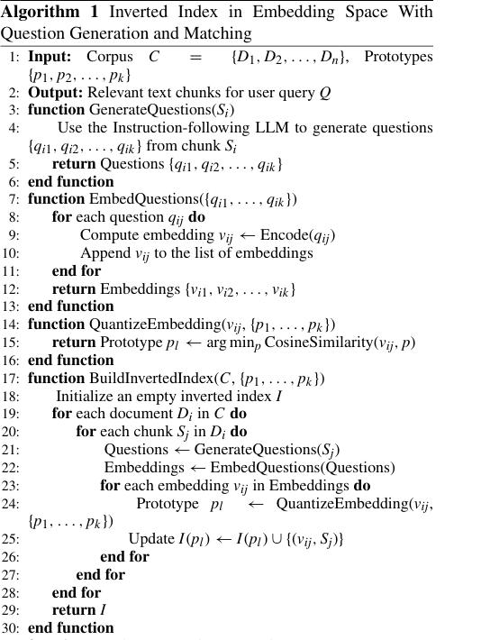
Algorithms used and how those algorithms work
QuIM-RAG leverages three key algorithms to enhance retrieval-augmented generation (RAG):
Inverted Index Construction Algorithm
Purpose:
Efficiently store and retrieve document chunks based on pre-generated question embeddings.
Use prototype-based quantization to improve lookup speed.
How It Works:
Generate embeddings for pre-generated questions using BAAI/bge-large-en-v1.5.
Cluster embeddings into prototype vectors (quantized embeddings).
Store prototype vectors in an inverted index, mapping them to multiple questions and document chunks.
Example:
"How do I apply for an internship?" and "What are the steps for internship applications?" → Mapped to the same prototype vector (P2).
P2 is stored in the index and linked to document chunks C1 & C3.

Slide 29
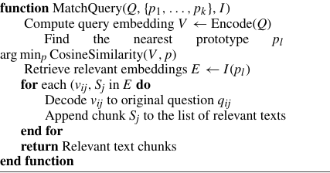
Query Matching Algorithm (Using Cosine Similarity)
Purpose:
Match user queries with the most relevant prototype vectors in the inverted index.
How It Works:
Convert user query into an embedding vector.
Find the closest prototype vector using cosine similarity.
Retrieve all mapped questions and linked document chunks from the index.
Example:
User Query: "How do I apply for an internship and what documents do I need?“
Query embedding vector: (0.30, -0.50, 0.75, ...)
Closest prototype vector (P2, similarity 0.97) → Retrieves chunks C1, C3
Second closest prototype vector (P3, similarity 0.92) → Retrieves chunks C2, C3

Slide 30
LLM-Based Answer Generation Algorithm
Purpose:
Generate accurate, context-aware responses using retrieved chunks.
How It Works:
Merge retrieved chunks into a structured input for the LLM.
Pass the structured input to Meta-LLaMA3-8B-instruct.
Generate a natural language answer while maintaining factual accuracy.
Example:
Retrieved Chunks (C1, C2, C3) → Passed as context to LLM
Final Answer:
"To apply for an internship at NDSU, students should explore opportunities on CareerLink or external job portals. Required documents include a resume, cover letter, and sometimes additional documents like a transcript or recommendation letter."

Slide 31
Summary of Algorithms Used in QuIM-RAG
Algorithm | Purpose | Key Steps
Inverted Index Construction | Efficiently stores and retrieves relevant document chunks. | Embeddings are clustered into prototype vectors and indexed.
Query Matching (Cosine Similarity) | Finds the most relevant prototype vector for a given user query. | User query is embedded → Nearest prototype is found → Linked chunks are retrieved.
LLM-Based Answer Generation | Generates a response using retrieved document chunks. | Retrieved text is passed to Meta-LLaMA3-8B-instruct for response generation.

Slide 32
DataSets Used…
QuIM-RAG is currently built using two main datasets collected from the NDSU Career Advising and Catalog websites. These datasets contain structured and unstructured text related to career guidance, job applications, internships, and academic policies.
1. NDSU Career Advising Dataset
Link: https://career-advising.ndsu.edu
Purpose:
Provides career-related guidance to students, covering resume writing, interview preparation, and job search strategies.
Helps in retrieval-augmented generation (RAG) by ensuring responses are based on real-world career resources.
Data Collection Process:
Scraped from the NDSU Career Center website (publicly available career resources).
Preprocessed to remove unnecessary content (headers, navigation menus, duplicate text, etc.).
Divided into structured chunks of 1000 tokens with 200-token overlaps to preserve context.
Generated question-answer pairs using GPT-3.5-turbo-instruct.

Slide 33
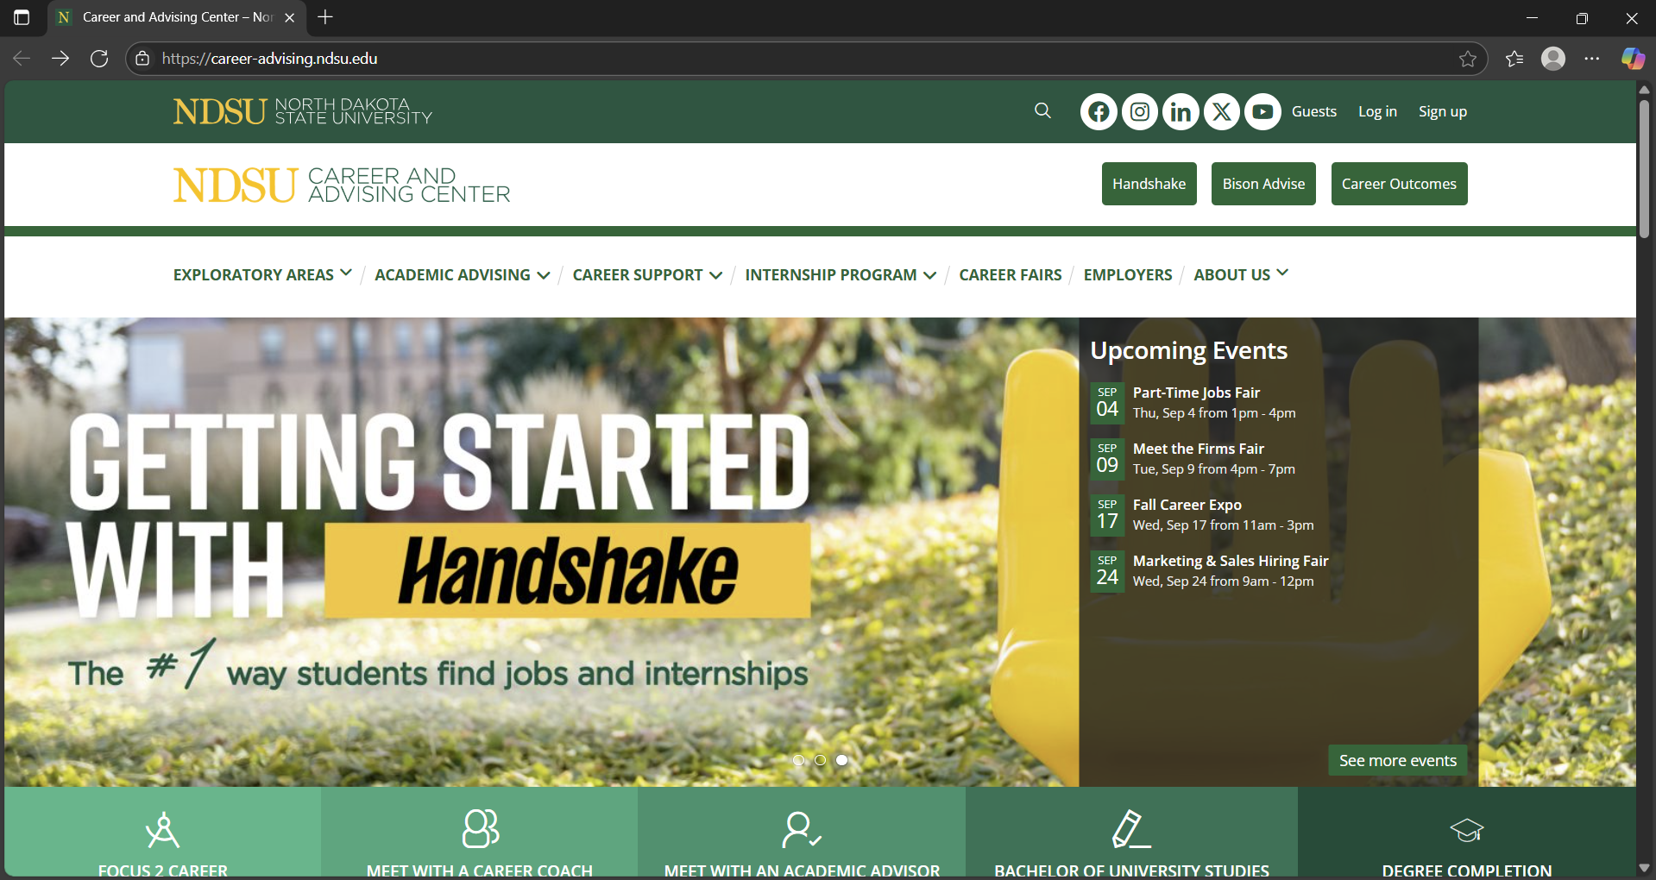

Slide 34
DataSets Used…
2. NDSU Catalog Dataset
Link: https://catalog.ndsu.edu
Purpose:
Provides academic-related information, including internship policies, degree requirements, and enrollment guidelines.
Helps ensure responses are based on official university policies.
Data Collection Process:
Scraped from the NDSU Career Center website (publicly available career resources).
Preprocessed to remove unnecessary content (headers, navigation menus, duplicate text, etc.).
Divided into structured chunks of 1000 tokens with 200-token overlaps to preserve context.
Generated question-answer pairs using GPT-3.5-turbo-instruct.

Slide 35
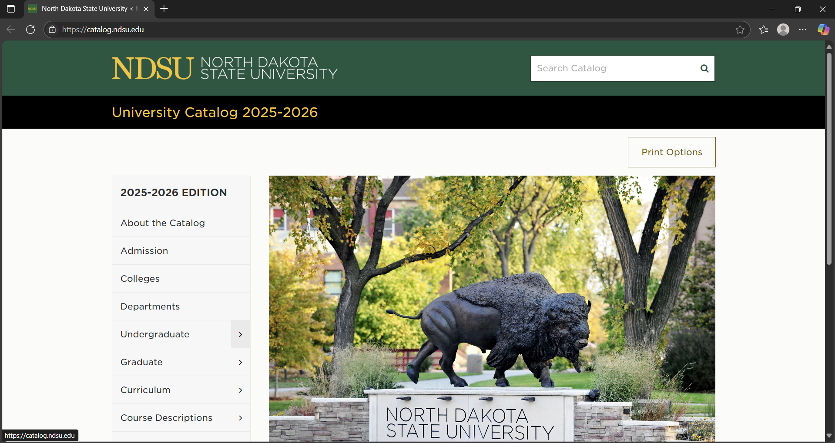

Slide 36
Experimental Setup…
The experimental setup of QuIM-RAG focuses on evaluating the retrieval and answer generation performance using quantized embeddings and an inverted index. The experiments compare QuIM-RAG with traditional RAG-based methods to assess improvements in retrieval accuracy, response faithfulness, and answer relevance.
1. Models Used
Embedding Model: BAAI/bge-large-en-v1.5 (used to encode questions & queries into vector embeddings).
LLM for Answer Generation: Meta-LLaMA3-8B-instruct (Hugging Face model for contextual response generation).
Database for Storage & Retrieval: ChromaDB (for indexing and searching quantized embeddings).
2. Baseline Models for Comparison
Model | Retrieval Mechanism | Answer Generation
Traditional RAG | Full embedding search (no quantization) | GPT-3.5-turbo-instruct
QuIM-RAG (Proposed Model) | Quantized embeddings + inverted index | Meta-LLaMA3-8B-instruct

Slide 37
Experimental Setup...
3. Evaluation Metrics Used
The QuIM-RAG system is evaluated using two primary frameworks:
BERTScore – Measures semantic similarity between generated answers and reference answers.
RAGAS (Retrieval-Augmented Generation Assessment Score) – Evaluates the faithfulness, answer relevance, and context relevance of generated responses.

Slide 38
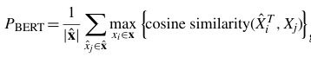
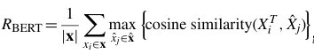
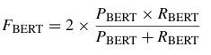
Experimental Setup...
1. BERTScore (Semantic Similarity Evaluation)
BERTScore is used to compare the generated response with the ground truth answer based on contextual embeddings rather than exact word matches.
Metric | Description | Formula | Target Score
BERTScore Precision | Measures how accurately the generated answer matches the reference answer by computing token-level similarity. |  | -
BERTScore Recall | Evaluates how well the generated answer covers all key information present in the reference answer. |  | -
BERTScore F1 Score | Combines precision and recall to give an overall measure of answer quality and completeness. |  | ≥ 0.85

Slide 39
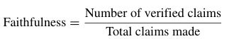
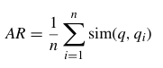
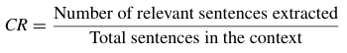
Experimental Setup...
2. RAGAS (Retrieval-Augmented Generation Assessment Score)
RAGAS evaluates how well the retrieved content supports the generated answer. It focuses on three key aspects:
Metric | Description | Formula | Target Score
Faithfulness Score | Measures whether the generated response is factually supported by the retrieved document chunks, avoiding hallucinations. |  | ≥ 0.90
Answer Relevance | Assesses the semantic alignment between the generated answer and the user’s original question using cosine similarity. |  | ≥ 0.85
Context Relevance | Evaluates whether the retrieved document chunks contain information that is directly useful for answering the query. |  | ≥ 0.75

Slide 40
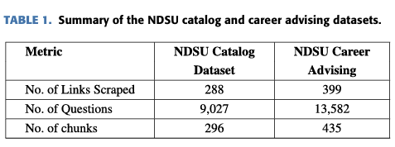
Experiment Execution Process...
Dataset Preparation:
Use the Career Advising & Catalog datasets (~22,609 Q&A pairs).
Preprocess text chunks and generate question embeddings.
Inverted Index Construction:
Cluster similar embeddings into prototype vectors (quantized representations).
Store prototype-to-question mappings for fast lookups.
Query Processing & Retrieval:
Convert user queries into embeddings.
Use cosine similarity to find the nearest prototype vector.
Retrieve all linked document chunks from the inverted index.
Answer Generation & Evaluation:
Pass retrieved chunks to Meta-LLaMA3-8B-instruct.
Compare generated responses with ground truth answers using evaluation metrics.
Notes:
Drawbacks Compared to QuIM-RAG:
Offers a broad overview without delving into specific innovative retrieval methods like QuIM-RAG's inverted question matching.
Lacks experimental validation of proposed methods.

Slide 41
Data Pipeline Overview...
Step | Process | Tools Used
1. Data Collection | Scraping university websites | BeautifulSoup, Scarpy
2. Preprocessing | Cleaning, text normalization | NLTK, spaCy
3. Chunking | Fixed-length & semantic segmentation | NLTK, Sentence Transformers
4.Questions Generation | LLM generates Questions | GPT-3.5-turbo
5. Embedding Generation | Convert text into vector representations | BAAI/bge-large-en-v1.5
6. Indexing | Store embeddings in an inverted index | ChromaDB
7. Retrieval | Query matching using cosine similarity | ChromaDB
8. Answer Generation | LLM generates response | Meta-LLaMA3-8B-instruct
Notes:
Drawbacks Compared to QuIM-RAG:
Offers a broad overview without delving into specific innovative retrieval methods like QuIM-RAG's inverted question matching.
Lacks experimental validation of proposed methods.

Slide 42
Conclusion…
QuIM-RAG Overview
QuIM-RAG is a retrieval-augmented generation (RAG) framework designed to improve retrieval efficiency, accuracy, and answer faithfulness using embedding quantization and inverted index-based search.
By leveraging prototype-based retrieval, it ensures faster query processing and more relevant document retrieval, significantly outperforming traditional RAG models.
Key Advantages:
Enhanced Response Quality: By integrating an advanced RAG system and a structured data preparation approach, QuIM-RAG significantly improves the accuracy and relevance of generated responses.
Reduction in Hallucinations: The use of a custom domain-specific dataset minimizes information dilution and hallucination, common in traditional RAG systems.
Improved Retrieval Performance: The system outperforms baseline models trained on raw web data by leveraging LLaMA-3-8B-instruct and a tailored dataset.
User-Verified Information: Responses include source links, allowing users to verify details and seek additional context.

Slide 43
Thank You

